Slide 1

Fraud Analysis & Anti‑Fraud Design
Analytical Insights & Anti‑Fraud Framework
Prepared for Cloudwalk
Presented by Rosa Mehrabi

Slide 2





Agenda
Understand the Industry
Analyzing the Data
Going Beyond Spreadsheet Data
Dashboard & Model Insights
Anti‑Fraud Solution Design
Conclusion

Slide 3

Understanding the Industry

Slide 4







Payment Flows & Key Players
Customer
Merchant
Gateway
Acquirer
Network
Issuer
Information flow
Money flow
Acquirer: Licensed bank holding settlement rights and risk.
Sub‑Acquirer: Aggregator managing onboarding & risk under the acquirer’s licence.
Gateway: Technical layer routing data; no funds movement.

Slide 5
Acquiring Market: Overview and Context
The acquiring market connects merchants to the card network ecosystem, enabling card acceptance.
Key Points
Card payments involve Issuers (banks), Acquirers (merchant banks), and Card Networks (Visa/Mastercard).
Issuers serve consumers; Acquirers serve merchants.
Networks define rules and move messages between both sides.
Customer ← Issuer ← Card Network → Acquirer → Merchant

Slide 6
Money Flow and Information Flow
Information moves first (authorization), money later (settlement).
Key Points
Authorization: Customer pays → Payment Gateway → Acquirer → Network → Issuer.
Issuer approves/declines → response travels back.
Settlement: Issuer transfers funds → Network → Acquirer → Merchant.
Timing: Authorization = data; Settlement = funds.
Top arrow = Information flow (bidirectional)
Bottom arrow = Money flow (post-settlement)

Slide 7
Main Players and Their Roles
Issuer: Provides cards, checks funds, absorbs fraud loss.
Card Network: Routes and governs rules.
Acquirer: Manages merchant onboarding, clearing, settlement.
Sub-Acquirer: Aggregates small merchants, handles tech + risk.
Gateway: Routes transaction data; no funds handled.
Merchant: Accepts payment.

Slide 8
Acquirer, Sub-Acquirer & Payment Gateway
The difference lies in license ownership, risk bearing, and function.
Key Points
Acquirer: Licensed financial entity; connects directly to card networks.
Sub-Acquirer (Aggregator): Works under an acquirer; holds merchant risk.
Gateway: Only transmits transaction data.
Aspect | Acquirer | Sub-Acquirer | Gateway
License | Yes | No (under acquirer) | No
Handles money | Yes | Yes (via acquirer) | No
Risk | High | Medium | Low
Function | Settlement | Aggregation | Routing

Slide 9
How the Flow Changes
Direct Acquiring: Merchant → Acquirer → Network → Issuer (Large merchants; direct relationship).
Sub-Acquiring: Merchant → Sub-Acquirer → Acquirer → Network → Issuer (Aggregated merchants; sub-acquirer absorbs fraud risk).
Gateway Model: Merchant → Gateway → Acquirer → Network → Issuer (Gateway only routes data).

Slide 10
Chargebacks vs. Cancellations
Both are reversals, but timing and origin differ sharply.
Chargebacks create reverse money flow and operational costs.
Key Points
Cancellation: Before settlement; merchant-initiated; low cost.
Chargeback: After settlement; cardholder-initiated; high cost.
Who triggers: Merchant vs. Issuer.
Why it matters: Chargebacks are direct financial losses and fraud signals.
Transaction stages
Authorization → Settlement → Post-settlement

Slide 11

Chargebacks vs Cancellations
Aspect | Cancellation | Chargeback
Trigger | Merchant/customer before settlement | Cardholder dispute after settlement
Money status | Authorization hold; funds not moved | Funds settled; reversal required
Who acts | Merchant / acquirer | Issuer via network
Timing | Fast (hours) | Slow (weeks)
Cost & Risk | Minimal cost; operational | High cost; reputational & fraud
Fraud link | Usually operational (not fraud) | Often fraud or friendly fraud
Chargebacks as Fraud Labels: Chargebacks provide the ground‑truth label for fraud; high chargeback rates expose acquirers to fines and losses.
[4]

Slide 12
Chargeback Lifecycle
-Cardholder disputes → Issuer initiates.
-Network notifies Acquirer → Merchant is debited.
-The merchant can “represent” with proof.
-Decision finalized by Issuer

Slide 13
Chargebacks and Fraud Connection
Chargebacks are the main feedback signal for fraud risk in acquiring.
High chargeback ratio → indicator of poor merchant quality or fraud ring activity.
Card networks monitor thresholds (~1%).
High ratio = acquirer penalties or license risk.
Fraud prevention aims to reduce chargebacks, not just detect fraud.
Risk Chain
Fraudulent transaction → chargeback → acquirer loss → acquirer pushes controls downstream → sub-acquirer / gateway implements fraud prevention
Key Points

Slide 14
Key Takeaways: The Logic of the System
The acquiring ecosystem balances trust, risk, and money movement.
Acquiring connects merchants to the card ecosystem.
Acquirers & sub-acquirers shoulder financial risk.
Gateways move data securely.
Chargebacks = main fraud signal.
Risk management protects both profitability and licensing.

Slide 15
Analyzing the Data

Slide 16
Set the Stage: Business Understanding
Before jumping into the data, let’s start by framing the goal:
To detect signs of suspicious behavior in transaction data that could indicate potential fraud.
Since all transactions come from mobile devices, the behavioral patterns and device-based correlations are particularly relevant.
The focus was to derive insights that would inform rules or models for real-time anti-fraud systems.

Slide 17

Dataset Overview
3,199
2,704
1,756
Transactions
Users
Merchants
1,996
$767
12.2%
Devices
Avg Amount
Chargeback Rate
Timeframe: 1 Nov – 1 Dec 2019 Data Quality: Complete; only device_id missing ~25%

Slide 18
Descriptive Observation
From a descriptive standpoint, the data looks quite representative of real-world payment behavior.
The average transaction amount is $767, with a wide range of $1 to $4,097, indicating both micro and high-value payments, typical of a mobile transaction base.
About 12.2% of transactions have chargebacks, which is substantially higher than typical payment-industry rates (usually under 1%), suggesting that the dataset includes strong fraud signals for analysis.
Majority of transactions are under $300, but high fraud occurs in >$1k bucket. Transactions peak during afternoon hours (12–18) and late evening (18–24). High fraud activity observed outside business hours.

Slide 19
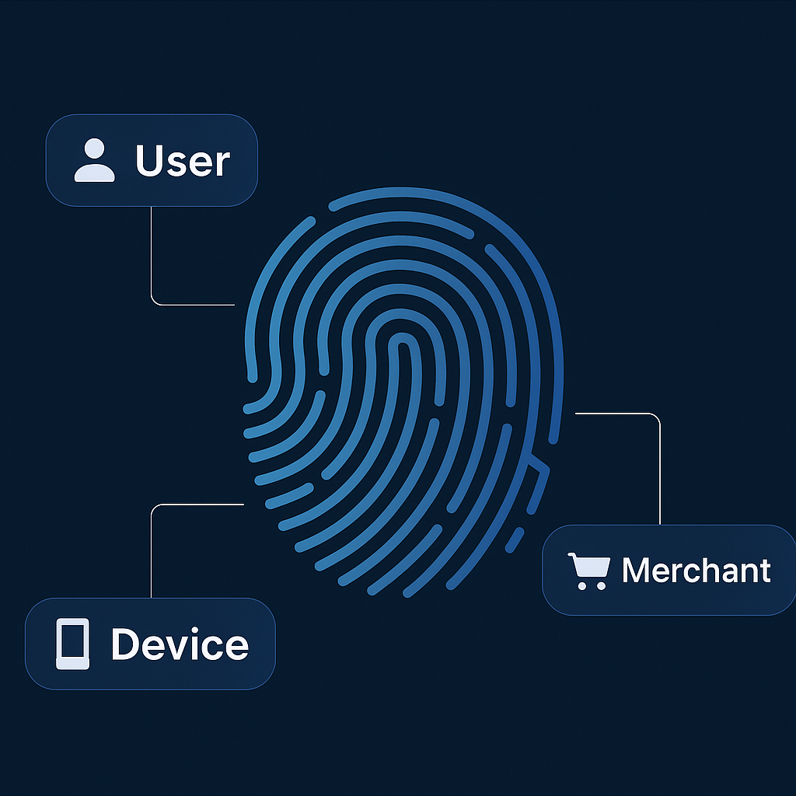
Behavioral Analysis

Slide 20
Grouped & Behavioral Analysis
I computed aggregated views by user, device, and merchant, extracted metrics like transaction velocity (in 10-minute windows), chargeback rate, activity span, and high-ticket ratios — this transforms your raw data into a risk behavior model.
The idea was to look for repeated suspicious activity, the same user, device, or merchant producing multiple chargebacks or high-value patterns within short time windows.

Slide 21
Suspicious Users
Users with 100% chargeback rates showed relatively high transaction values, often between $2,000 and $4,000 per purchase, much higher than the dataset’s average of $767.
For example:
User 17929 → 6 transactions, total $21.8K, with transactions up to $4,095.
User 99396 → 5 transactions, total $10K, across multiple merchants and devices.
User 75710 → 10 transactions, rapid bursts within ~24 hours.
These are classic signs of coordinated fraud or mule accounts, users performing multiple high-value transactions that are later reversed.

Slide 22
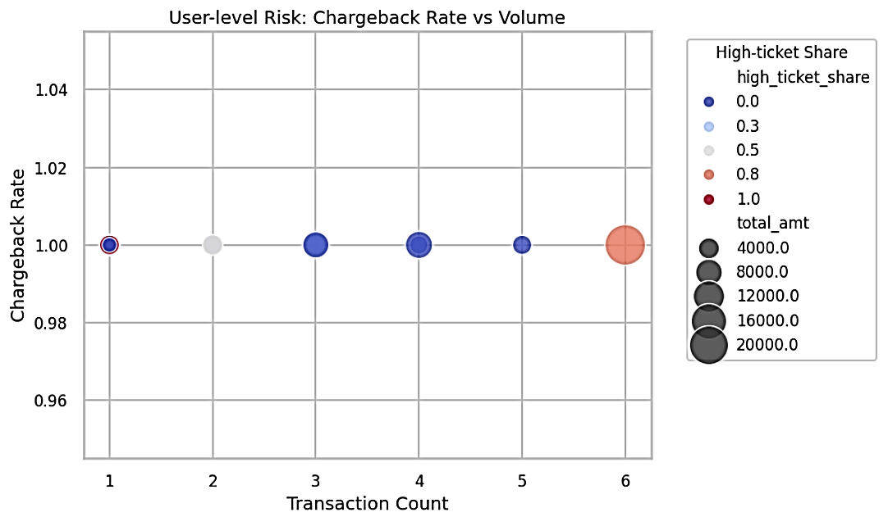
Chargeback Rate vs Transaction Behavior
Clear behavior types:
Low-volume probes (1–2 tx): Possible Card-testing.
Higher-volume actors (5–6 tx): Adaptive, Delayed Detection.
One high-ticket outlier (~$20K exposure), Likely Cash-out Attempt.
Fraud pattern: deliberate small-value camouflage vs big-value exploitation

Slide 23
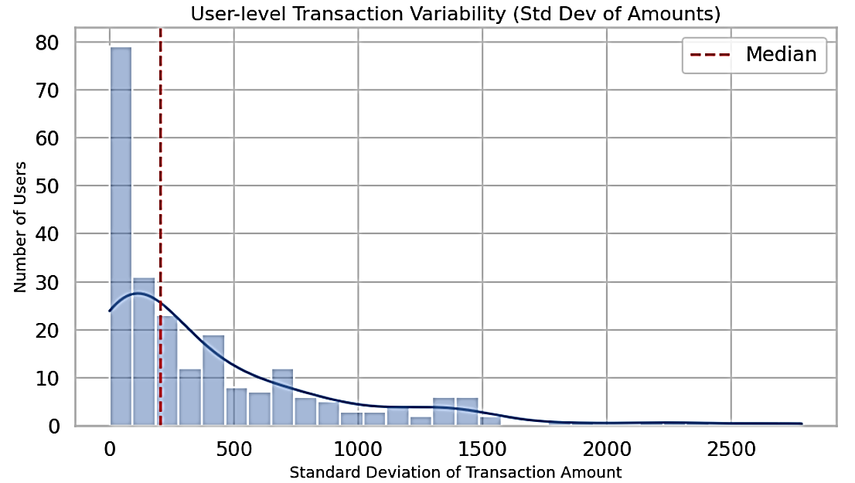
Detecting Behavioral Outliers
Majority of users show low variability (0–300), consistent, normal spending.
Long right tail (>1,000): few users with erratic spending behavior.
High-variance users: potential fraud rings or cash-out attempts.
Median near 0 → confirms most users stable; outliers are rare but high risk.
Fraud pattern: “test small spend big” sequence common in card testing fraud.
While 95% of users behave predictably, it’s the last 5% on the far right that matter most; that’s where fraud hides.

Slide 24
Suspicious Devices
At the device level, some devices were repeatedly used for fraudulent transactions across one or more users and merchants.
For instance:
Device 960729 processed 6 transactions for 2 merchants, all chargebacks, totaling $21.8K.
Device 357277 also shows 6 transactions, all chargebacks, over 2 merchants.
Device 174844 had 5 transactions, all chargebacks, totaling $2.9K.
This pattern suggests that the same physical or virtual device may have been used for multiple fraudulent user accounts, possibly indicating device spoofing or shared fraudulent infrastructure.

Slide 25
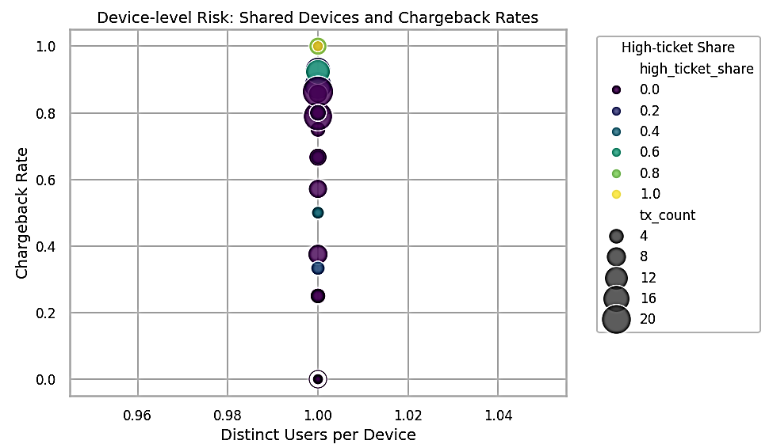
Shared Devices and Chargeback Behavior
Most devices are tied to a single user: minimal device sharing.
Vertical dispersion: devices ranging from clean to 100% fraud.
Large bubbles high on the y-axis: heavily used, confirmed fraud devices.
Dark bubbles: low-value fraud (testing).
Green/yellow bubbles: high-ticket, “premium” fraud patterns.
Actionable next step: Prioritize device fingerprinting and cross-user velocity checks to catch recurring fraud hardware.

Slide 26
Suspicious Merchants
Finally, zoom out to the merchant-level, where Cloudwalk’s business risk lies.
At the merchant level, several entities exhibit systemic fraud exposure:
Merchant 1308: 15 transactions, 100% chargebacks, $34.5K in volume, short time span (under a day): Fraud Ring Aggregator
Merchant 44927: 11 transactions, all chargebacks, $9.2K over six days (several on the same day)
Merchant 73271: 10 transactions, all chargebacks, $14.5K, spanning multiple devices and users: Exploited Merchant
These merchants are prime candidates for merchant account suspension or manual review, as they combine high fraud ratios with significant transaction volume.

Slide 27
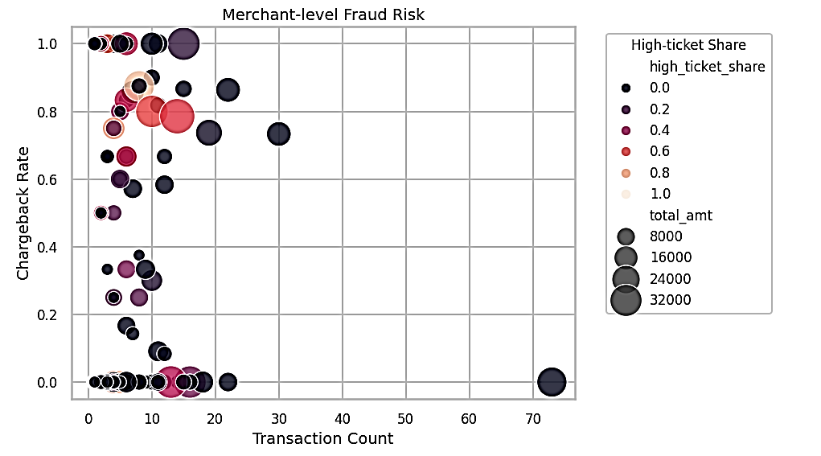
Identifying Synthetic and High-Impact Merchants
High cbk (>0.8), low volume (<20): likely synthetic or temporary fraud merchants.
High cbk + high ticket share: medium-volume but high-loss merchants.
Low cbk (~0): stable, legitimate merchants.
Fraud clusters indicate fake storefronts or chargeback laundering rings.
Actionable next step: tighten merchant onboarding risk scoring & volume anomaly alerts.

Slide 28
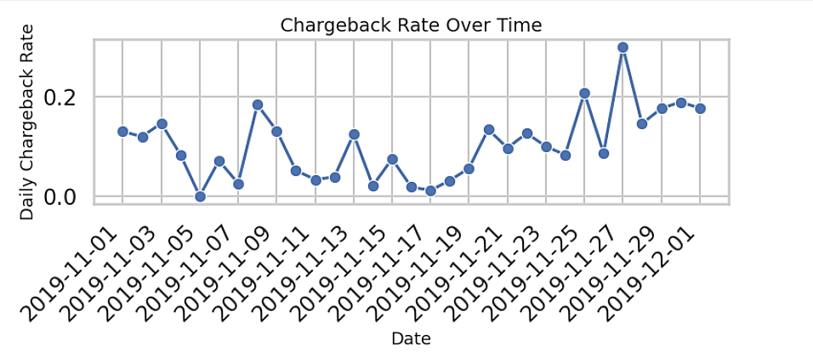
Temporal Risk Pattern; Chargeback Rate Over Time
Chargeback rate fluctuates between 5–20% daily.
Spikes around Nov 9 & Nov 27: Peaking around Nov 27–29 at ~30 %. That date range aligns with Black Friday week, a period when fraudsters typically exploit higher transaction traffic and relaxed review thresholds.
Gradual increase toward month-end: adaptive or delayed fraud detection.
Suggests fraud campaigns cluster in short time windows.
Actionable next step : implement rolling time-window monitoring and velocity-based rule triggers

Slide 29

Fraud Patterns & Temporal Trends
Temporal insights: • Baseline 5–10% early month • Black Friday spike ≈30% (Nov 26–30) • Elevated post‑peak indicates residual fraud

Slide 30
Summary of Behavioral Analysis
In short, fraudulent activity is not random. It’s concentrated in a small network of merchants, users, and devices, all linked by 100% chargeback patterns and high transaction values.
This implies organized fraud rings or compromised accounts rather than isolated card theft.
To push analysis further, I benchmarked it against standard AML and fraud typologies:
Despite the dataset being synthetic and limited to one month, I could still extract signals of structuring, velocity abuse, shared devices, and automation.
Patterns like high-value outliers, multiple users sharing devices, and 100% chargeback clusters suggest a mix of synthetic identity and merchant collusion, which would be key features to feed into an anti-fraud model.
High‑ticket users produce outsized losses despite fewer transactions Shared devices and merchants indicate mule networks & collusion.

Slide 31

Identifying overall suspicious patterns across the dataset

Slide 32
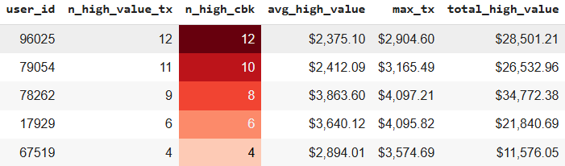
High-Value Fraud Concentration; Suspicious User Behavior
A small cluster of users repeatedly executed high-ticket transactions (>$2,000) with exceptionally high chargeback rates, indicating deliberate high-value fraud behavior aimed at maximizing payout per successful authorization.

Slide 33
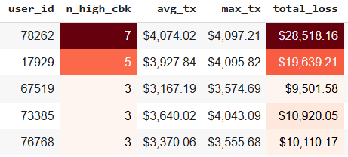
Top High-Value Fraudsters; Confirmed Loss Concentration
A small set of users repeatedly executed high-value transactions (top 5%) that were charged back multiple times, indicating intentional high-value fraud behavior consistent with cash-out or testing strategies.

Slide 34
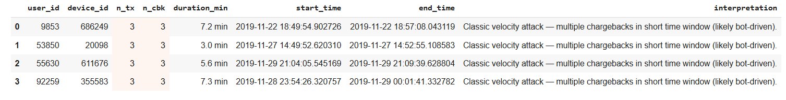
Velocity Fraud Detection; Rapid Transaction Bursts
Detected multiple short-time bursts (≤10 min) of transactions with ≥2 chargebacks. A strong indicator of velocity fraud, where fraudsters rapidly test stolen cards or automate repeated payment attempts.

Slide 35
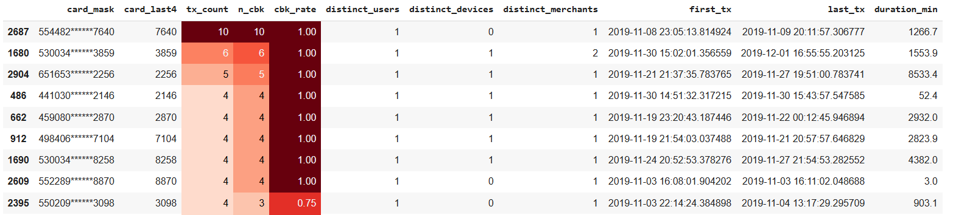
Card Reuse and Cross; Merchant Fraud Linkages
Multiple masked cards were reused across several transactions, and clusters with chargebacks indicate card testing/replay on the same device or spread across merchants to evade simple rules.

Slide 36

Going Beyond the Spreadsheet Data

Slide 37
Additional Data Enrichment
In real-world acquirer environments like Cloudwalk’s, fraud detection improves exponentially when we enrich transactional data with contextual, behavioral, and device intelligence:
KYC & User Identity: Cloudwalk’s mobile-first merchant ecosystem often sees synthetic IDs or re-used CPF numbers; linking user-level data helps identify Identity Recycling.
Device & Network Intelligence: Fraud rings often use emulators or rooted phones to cycle through multiple merchant accounts. Cross-referencing device and user behavior can isolate those clusters.
Payment Instrument & Financial Data: Card BIN metadata, Tokenization history, Issuer response codes, etc. Because BIN-country mismatches and card-testing are early indicators of organized fraud networks.
Geolocation & Behavioral Context: Geospatial coherence, Time-zone alignment, Distance & movement analysis. Because Cloudwalk’s merchant base spans all Brazilian states, geospatial anomalies can uncover fake merchant terminals or remote fraud rings.
Merchant category & onboarding data: Cloudwalk’s value prop is empowering small merchants, but fraudsters exploit that agility. Merchant-level clustering helps catch fake storefronts or shell merchants.

Slide 38
Dashboard & Model Insights

Slide 39
Fraud KPI Dashboard — Foundational Risk Indicators
Interactive Dashboard
• Dynamic filtering by user, merchant & time • Risk heatmap highlights high‑CBK merchants & devices • Top 10 merchants account for 62% of chargeback volume • Identify cross‑merchant device reuse & mule networks
Model Overview
Features: user, device, merchant, amount, hour, prior transaction & chargebacks Balanced dataset via oversampling & class weights Logistic regression chosen for interpretability & efficiency Threshold tuned to minimize false negatives
[5][6][7][8]

Slide 40
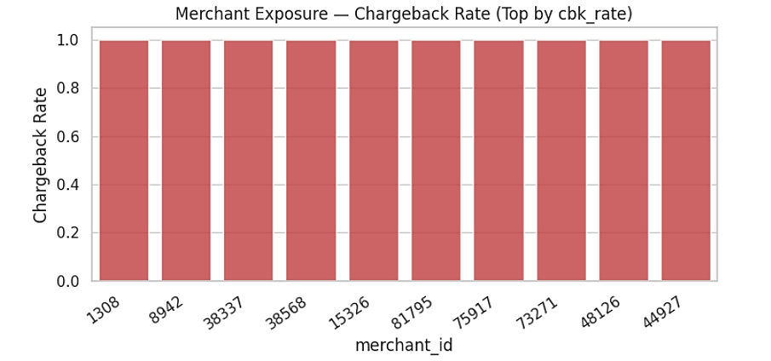
Insight: Top merchants by cbk_rate show concentrated fraud exposure, apply tighter limits, step-up auth, or manual review.

Slide 41
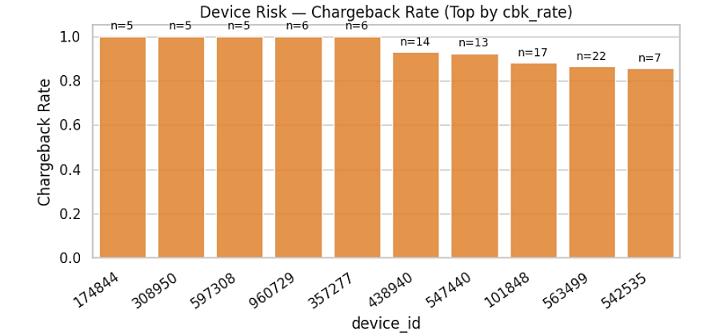
Insight: High-cbk devices (often reused across users/merchants) suggest emulators or compromised devices, fingerprint & throttle.

Slide 42
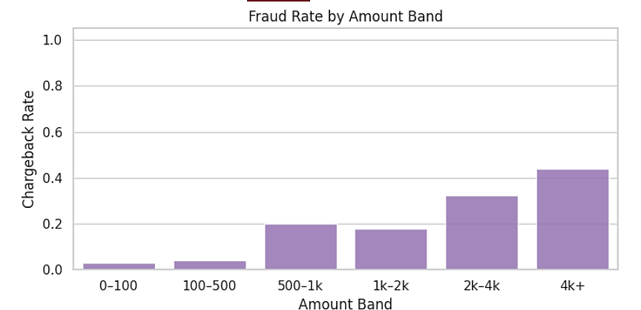
Insight: Higher amount bands (e.g., ≥ $2k) typically show elevated fraud rates, fraudsters maximize payout per successful auth.

Slide 43
Implementation of the Solution

Slide 44
“Operational Dimensions” VS. “Fraud Rules”
Implementation layer | Analytical validation layer | Their Connection
Antifraud Requirement 1: Reject if the user tries too many transactions in a row | Velocity ≥3 tx / 10min (Fraud rate 66.7%, 5.5x lift) | Exactly corresponds: This rule targets rapid-fire transactions, a classic velocity attack pattern.
Antifraud Requirement 2: Reject transactions above a certain amount | High-ticket > $2k (Fraud rate 38.8%, 3.2x lift) | Direct link: High-value purchases are strongly correlated with cash-out fraud.
Antifraud Requirement 3: Reject if user had a prior chargeback | Prior chargeback link (Fraud rate 84.8%, 6.9x lift) | Direct link: Users or devices tied to historical chargebacks are the most predictive fraud indicators.
(Additional related pattern) | Cross-merchant reuse (Fraud rate 100%, 8.2x lift) | Extends antifraud logic: This would require network-level visibility to detect the same device/card being reused across merchants.

Slide 45
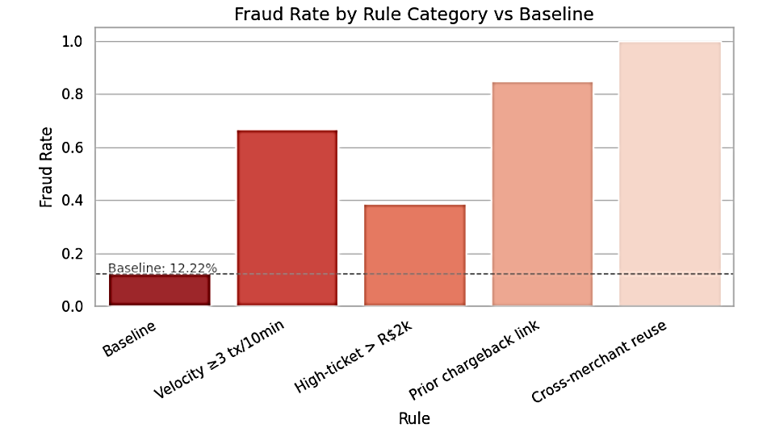
Each rule targets specific high-risk behavior.
Bars above the baseline indicate higher fraud concentration.
Velocity and Prior-Chargeback rules often show >2× the baseline fraud rate (high precision, good auto-block candidates).
High-ticket and Cross-Merchant rules capture fewer cases but with meaningful fraud lift.

Slide 46
Anti‑Fraud System Design:
System principles • Real‑time endpoint built with FastAPI • Rule layer filters obvious fraud quickly • Logistic regression scores risk on enriched features • Configurable threshold returns approve/deny/review
Transaction
Input
Data & Feature
Enrichment
Risk Scoring
Decision
Payload: user, device, merchant, amount, timestamp
Add identity, device, BIN, geo & history
Apply velocity & high‑ticket rules; compute logistic regression score
Compare score to threshold & return approve / deny / review

Slide 47
Real-Time Anti-Fraud API: FastAPI /antifraud Endpoint
Goal: Serve real-time fraud checks through a lightweight, low-latency REST API.
Framework: FastAPI + Uvicorn (async, production-grade)
Endpoint: POST /antifraud
Port: 8001 → Swagger Docs
Latency: p50 = 8.3 ms, p95 = 15.1 ms (20-request benchmark)
Decision Logic: Rule-Based Engine
Example API Response:
INFO: 127.0.0.1:60746 - "POST /antifraud HTTP/1.1" 200 OK 200 { "decision": "APPROVE", "echo": { "transaction_id": 22320398, "merchant_id": 92895, "user_id": 2708, "card_number": "444456******4210", "transaction_date": "2019-12-01T22:45:37.873639", "transaction_amount": 734.87, "device_id": 497105 } }
Highlights: Instant scoring (<15 ms avg) Transparent rule-based explainability Seamless integration with the ML scoring model

Slide 48
Fraud Detection Model: Score-Based Logistic Approach
Goal: Detect and prevent fraudulent transactions using explainable, fast, and production-ready machine learning.
Data Inputs: Transaction history (user, merchant, device, card)
Feature Engineering:
Behavioral stats (past chargeback rates, transaction counts)
Temporal features (hour, weekend, night flag)
High-ticket threshold (≥ 2775.27)
Frequency & rate encodings for user/device/merchant/card BIN
Model: Logistic Regression (balanced classes, standardized features)
Performance:
Train accuracy: 98.46%
Test accuracy: 98.5%
Output: Continuous fraud probability (0–1)
Example Scoring: Transaction ID 2342357 → Risk Score 0.0012 (Approve) → Indicates normal behavior, well below the rejection threshold (0.6)
Key Benefits: Simple & transparent Fast inference for real-time scoring Easily extendable with historical / z-score features

Slide 49


Conclusion & Recommendations
Prioritise High‑Risk Entities
Implement Multi‑Layered Rules
Suspend merchants, users & devices with 100% CBK and investigate deeply.
Enforce velocity, high‑ticket & reuse rules to block obvious fraud.
Enrich Data Sources
Iterate & Scale Models
Integrate KYC, device fingerprinting, geolocation & BIN intelligence.
Train ML models on enriched features; calibrate thresholds & monitor drift.

Slide 50
Final thought
Fraud prevention is both a technical and a business imperative. By combining data‑driven insights, layered rules, and adaptive models, Cloudwalk can protect merchants and enable trust at scale.
Fraud at Cloudwalk isn’t random; it’s patterned, multi-layered, and time-sensitive.
Detecting it effectively requires connecting entities, users, devices, and merchants, and applying adaptive rules that evolve with fraud behavior

